Slide 1

Health Insurance Application
Health
Insurance Application
Digitalization
of Business Process
Florian Büttiker
Oliver Freiermuth
Karimi Moahammad Ali
Pasquale Biafora

Slide 2
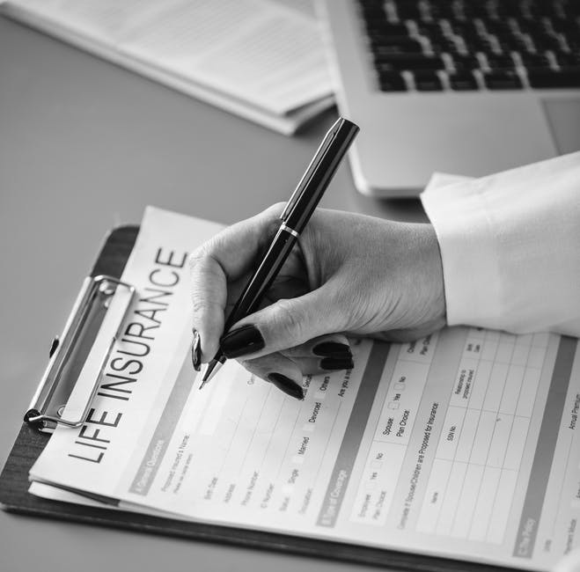
Agenda
AS-IS Situation
Customer Experience
Digitalized Process
Comparison
Demo
Questions
06-Jun-18
2

Slide 3
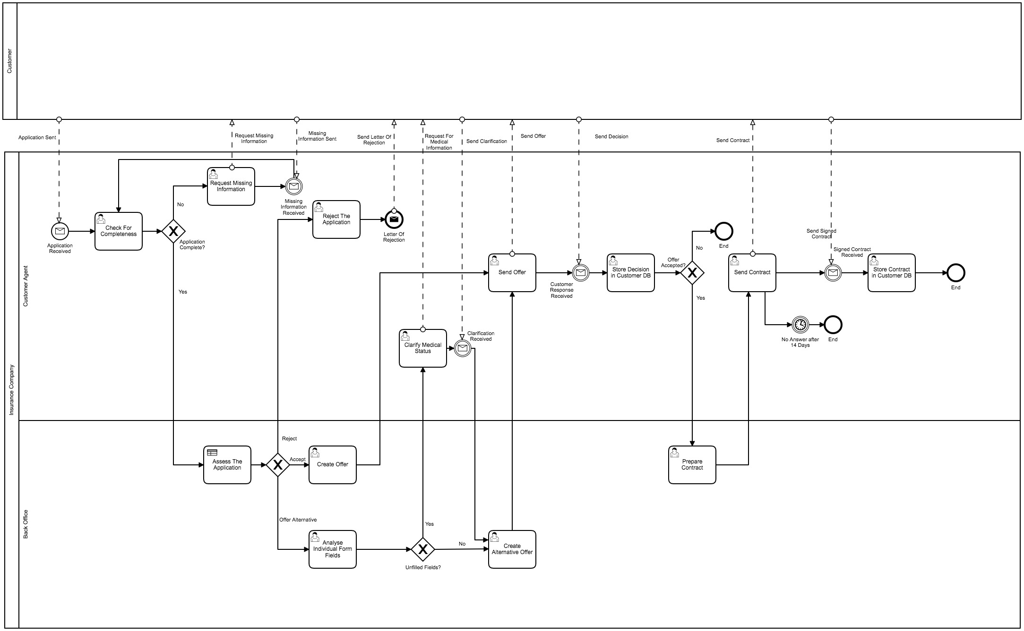
AS-IS Situation
06-Jun-18
3

Slide 4



Customer Experience
Individual consultancy
Personal Interaction
Only offline communication
No traceability
Speed
Many mistakes (decision table is applied manually)
06-Jun-18
4

Slide 5
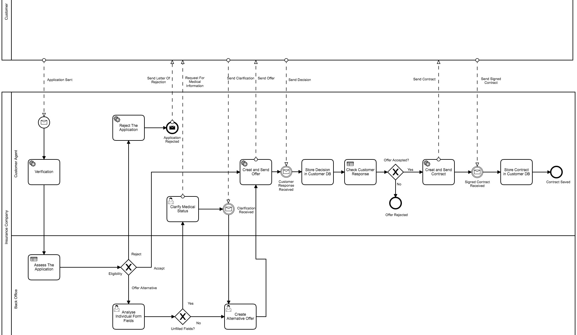
Digitalized Process
06-Jun-18
5

Slide 6

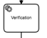
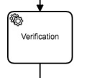

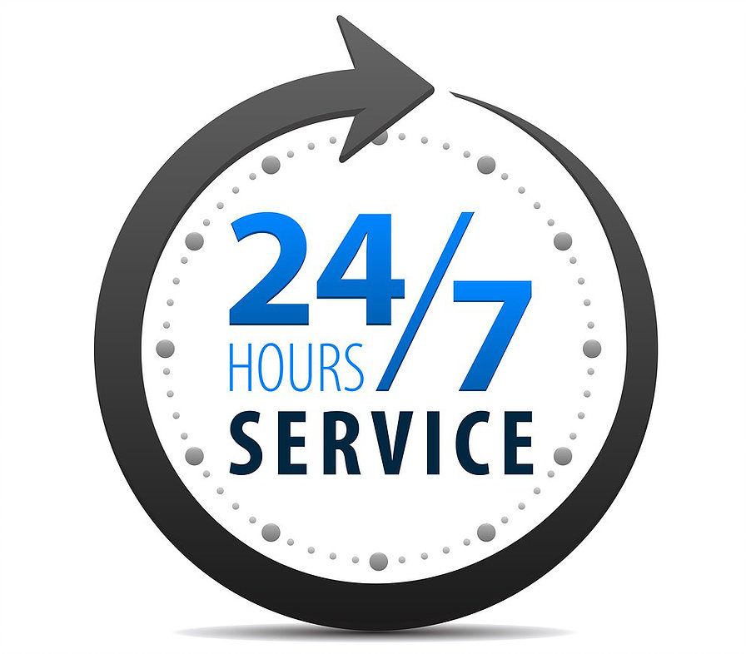
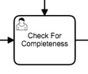
Comparison
Mostly automated script tasks
No media breaks
Elimination of unnecessary tasks (e.g. data check)
Online-Process (24/7)
06-Jun-18
6

Slide 7

Demo
Picture source: Own Illustration
06-Jun-18
7
06-Jun-18
7

Slide 8

Questions

Slide 9

Thank you for your attention.
06-Jun-18
9

Slide 10
Source citation
All pictures are from: https://www.pexels.com/
All icons are from: https://www.flaticon.com/
06-Jun-18
10
06-Jun-18
10

